Slide 1


New Staff
Health & Safety Induction training
–LaSIE – UMR CNRS 7356
2019

Slide 2

Contents
Why a Health and Safety induction
Introducing the work unit (UT) and safety advisors for the prevention of occupational hazard
How to participate to the prevention of occupational risks ?
How to report a danger ?
In case of fire?
In case of medical emergency ?
Conclusion

Slide 3
Why a Home security ?

Slide 4
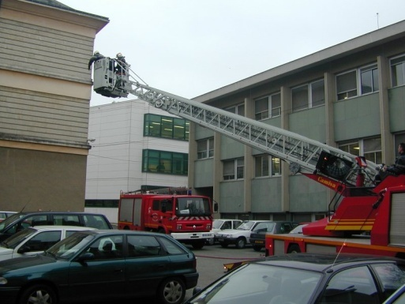
Why a Health & Safety induction ?
Safety training has always been a necessity and has become an obligation for all staff, especially for new members of staff
Goal:
To instill the right reflexes from
the start
To teach staff the precaution to be
taken to ensure
  their own security
  their co-workers,
  where relevant, department users safety

Slide 5
Why a Health & Safety induction ?
Training of newcomers
Décret 82-453 article 6
(+ code du travail L4141-1)
Pratical and appropriate training in hygiene and safety shall be organized
1° When employees start work
2° During a change of job, technique, workplace ...
Notes:
Accueil sécurité :
général (par Myriam lors de la journée d’accueil)
et spécifique (par l’AP au sein de l’UT).

Slide 6
Why a Health & Safety induction ?
Training of newcomers
To introduce you to the staff dealing with occupational health and safety issues (executive and field staff)
To be aware and be able to follow the safety instructions and procedures implemented at the University
To report any workplace safety problems
To implement emergency measures if required (right of withdrawal in case of serious and imminent danger, basic reflexes in first aid and fire safety)

Slide 7
Why a Health & Safety induction ?
Training of newcomers
WITHIN YOUR WORKING UNIT:
PRACTICAL AND ADEQUATE TRAINING
safety actors in the lab and premises
Access inside and to the workplace (with a visist to the work premises)
General working procedures
Generally carried out by the safety advisor and/or by the direct supervisor of the agent

Slide 8
Presentation of LaSIE and actors in the prevention of occupationnal Risks (RP)

Slide 9
UT and prevention actors
Organization LaSIE

Slide 10
UT and prevention actors
The Unit Manager
Integrates prevention at all stages of activities under his/her responsibility
Enforces statutory obligations the rules and regulations tobe complied with in the institution
Appoints a local safety advisor within the unit
Ensures that personnel under his autority receive appropriate training in health and safety
Maintains facilities in compliance
Ensures good professionnal practice
Informs the dean of the faculty of any accident or near-misses or serious hazards
All this does not relieve other staff members from their involvement in the overall safety of the department

Slide 11
UT and prevention actors
The Supervisors
In connect with the safety advisor and, if necessary, the head of the work unit (including the building manager, the HSE department and, if applicable, the partner research organization)
  Assesses any new activity risks , defines and implements adapted preventive measures
  Is involved in defining each individual occupational risk exposure list
  Participates in Health and Safety training
  Keeps the work unit manager informed :
      Of any new research / teaching activity or the replacement, movement or purchase of equipment requiring special safety measures and complies with the current regulatory requirements ,
      Of Safety problems that he considers he is unable to solve, and of any accident / near misses that has occured

Slide 12
UT and prevention actors
The Supervisors
Whatever their position ( reserach team leader, training, team leader, service manager, thesis supervisor …..) they actively work at setting up rules towards the prevention policy of occupational hazards for staff under their authority
Especially have to ensure that staff under their authority are informed of the particular risk encountered at their workplace and that the safest working methods are known by everybody.

Slide 13
UT and prevention actors
The New Staff members
Ensure their own safety, that of their colleagues and that of the users
Participate in risk assessment
Learn about professional best practices and arrangements required in the event of an accident or disaster
Complie with statutory laws and regulations and instructions
Notify their department manager of any accident or near-miss
When they detect a hazard, they inform their supervisor, and record it in the safety register kept by the safety advisor

Slide 14
UT and prevention actors
Safety advisor
Assist and advise the Ut and/or building manager
Collaborates with prevention counselor
Take part in :
  The setting up of a risk prevention policy
  The risk assessment process
  The implementation of occupational health and safety rules
  Training / information for staff

Slide 15
UT and prevention actors
Organisation LaSIE
Unit Manager
X. FEAUGAS
Your local Safety advisor
COHENDOZ Stéphane
Rez de Chaussée Aile B du Bât Curie
Tel : 86-10
Supervisor
GELICUS Antony
Rez de Chaussée et 1^{ier} étage Aile A - Curie
Tel : 76-55
YOU
REBERE Christelle
2ème étage Aile B du Bât Marie Curie Hygiene and Safety Correspondent at the CNRS regional delegation
Tel : 72-95
Notes:
Insérer les photos des AP, leurs noms, prénoms …

Slide 16
Rules of access to the UNiT

Slide 17
Rules of access to the UNiT
Tour of LaSIE - RDC
Access area pedestrian
LaSIE
Fire and Emergency area
Reception LaSIE
Access area car park

Slide 18
Rules of access to the UNiT
Tour of LaSIE – 1 St Floor
LaSIE

Slide 19
Rules of access to the UNiT
Tour of LaSIE – 2nd floor
LaSIE

Slide 20
Rules of access to the UNiT
Tour of LaSIE – Fourier
LaSIE

Slide 21
Rules of access to the UNiT
Tour of LaSIE – Fourier (Level 1)

Slide 22
Rules of access to the UNiT
Tour of LaSIE – CCA
LaSIE
MEB
MET

Slide 23

Rules of access to the UNiT
  Opening days and hours
      Monday to Friday from 7.30am to 7.30pm
      Saturday 8.00am to 12.00 am for students and lecturers
      For technical and administrative staff (Hamac application)
  Access
      Swipe card
      Requests for keys and code (intrusion alarm) to be addressed to Nadine Seguin
  Lone working / working outside regular hours
      lone working must be exceptional and should be managed in such a way that the worker is rescued at short notice in the event of an accident. In cases where hazardous work must necessarely be carried out outside normal working hours and /or in remote locations, it is compulsory to be accompanied or to implement appropriate compensatory measures.
      The lone working from must be completed and signed by the member of staff working by himself, the director or the deputy director. It shall be addressed to security staff who must be informed at all times.

Slide 24
Rules of access to the UNiT

Slide 25
How to participate in the prevention of occupational risks?

Slide 26
How to participate in the prevention of Risk?
How to assess risks?
  Identify your activities
  Define the dangers
  Define the conditions of exposure
  Add the data into the Safety log book (DUER) with the safety advisor
Deduct the level of risk
Define the means of protection to be implemented

Slide 27
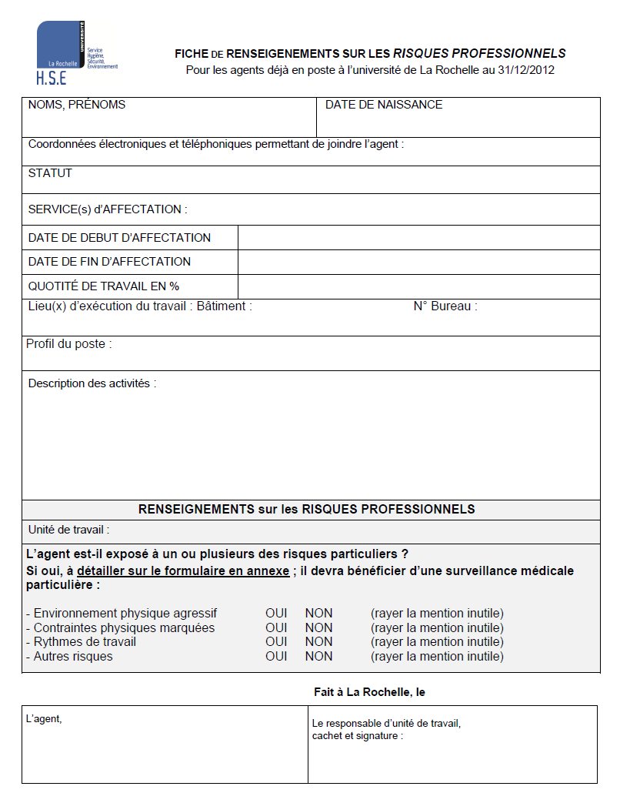
How to participate in the prevention of Risk?
The dangers of your activity

Slide 30
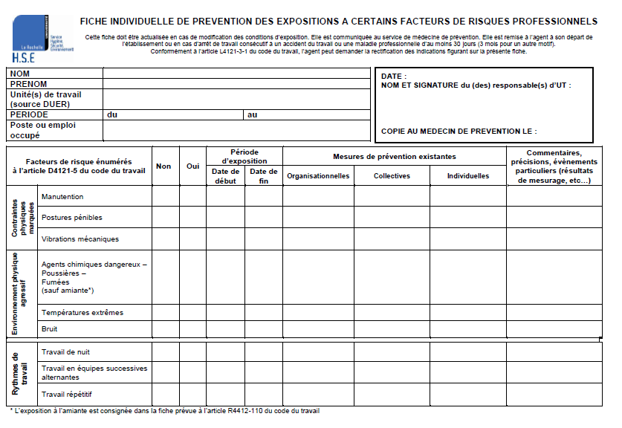
How to participate in occupational risk prevention?
Individual index card of traceability of the exposures

Slide 31










How to participate in the prevention of Risk?
The main hazards in the lab
Chutes
Electricity
pressure equipment
Fire
Laser
Cryogenic liquids and gas
Manuel handling
Ionising radiation
No-Ionising radiation
Chemical risk
Occupational stress
Display screen Equipment (DSE)
Notes:
Exemple.

Slide 32
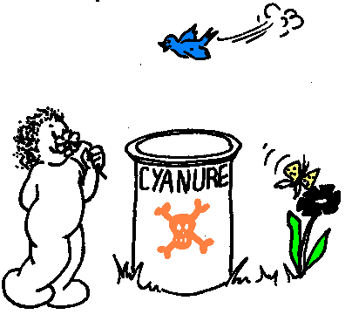
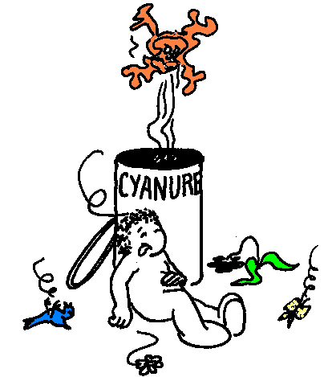
How to participate in occupational risk prevention ?
How to assess risks?
Danger X
Exposure =
Risk
conditions of use (frequency, duration, amount, dilution)
protections (collective, individual)
Behavior of the manipulator (trainig, respect of rules)
Chemical peoduct
(toxicity)
intoxication

Slide 33
How to participate in occupational risk prevention?
How to protect yourself from risks?
Work obligation
Written protocol
Analysis of each step:
- need in products
- necessary materials
- provision of EPC
- PPE requires
- waste
- Special training?...
Notes:
Développer la présentation des principaux risques spécifiques à votre UT.

Slide 34
How to participate in occupational risk prevention?
How to suppress/decrease risks?
Intinsic prevention
Collective protection
Individual protection
instructions

Slide 35
How to participate in occupational risk prevention?
How to protect yourself ?
TECHNICAL & COLLECTIVE ASPECT
products, equipment, waste, premises, technology,
environment, periodic control,
ORGANIZATIONAL ASPECTS
delegations, workforce, duration of work, lone working,
management of external companies,CP / AP, medicine, CHSCT,
SHSE,
HUMAN & INDIVIDUAL ASPECT
  PPE, qualification and statut of staff, skills,
  training, information, medical issues…

Slide 36









How to participate in occupational risk prevention?
How to be aware of risks ?
Pictograms of prohibition

Slide 37










How to participate in occupational risk prevention ?
How to be aware of risks ?
Pictograms of obligation

Slide 39
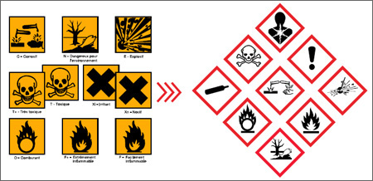
How to participate in occupational risk prevention?
How to protect yourself from risks?
Main riks specific to the WU
Notes:
Développer la présentation des principaux risques spécifiques à votre UT.

Slide 40
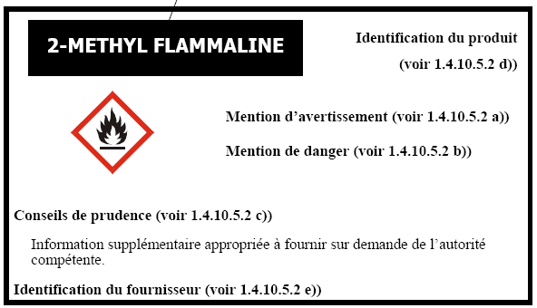
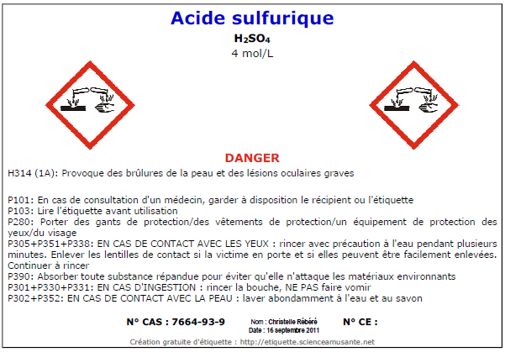
How to participate in occupational risk prevention?
How to protect yourself from risks ?
The label
The label on the bottle
http://etiquette.scienceamusante.net/sgh/index.php
Notes:
Développer la présentation des principaux risques spécifiques à votre UT.

Slide 41
How to participate in occupational risk prevention?
How to protect yourself from risks?
The Label
Labelling = useful for the company/ manipulator
- It immediately informs the user of the product
- It avoid confusions and errors of manipulation
- It helps to organize prevention
- It is a choice for the purchase of products
- It is a guide for the storage of products
- It immediately helps in case of an accident
- It gives advice on the disposal of dangerous products
Notes:
Développer la présentation des principaux risques spécifiques à votre UT.

Slide 42

How to participate in occupational risk prevention?
How to protect yourself from risks?
To be well equipped
    Wearing closed-toc shoes
    Wearing trousers
    Tie long hair back
    Do not use contact lenses
    Do not drink and est in the lab
    Wash hands after handlings
Notes:
Développer la présentation des principaux risques spécifiques à votre UT.

Slide 43
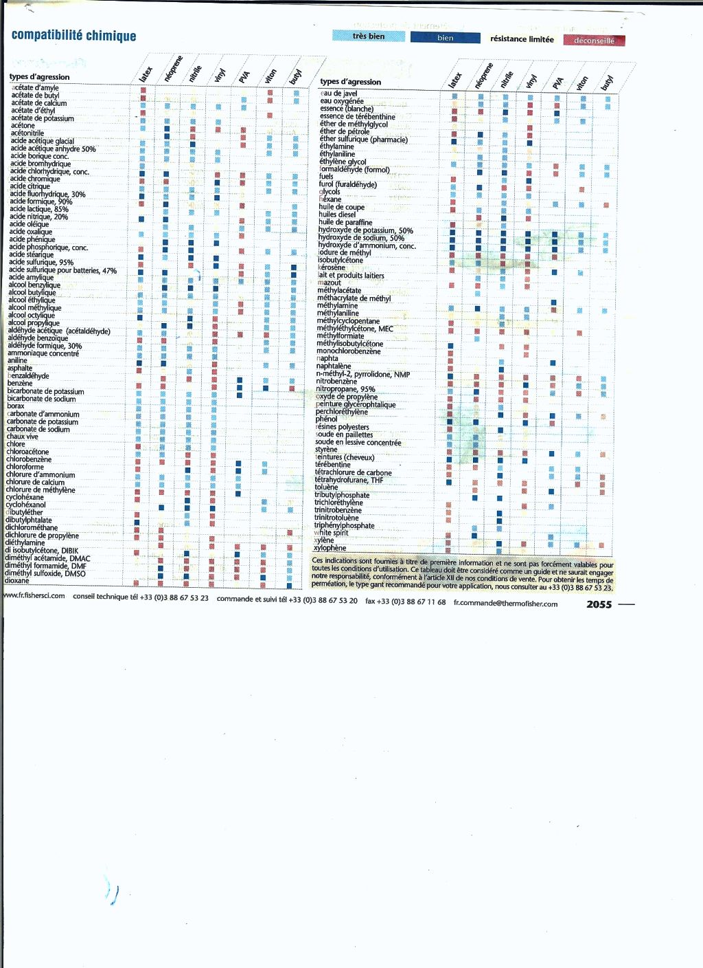
How to participate in occupational risk prevention?
How to protect yourself from risks?
Notes:
Développer la présentation des principaux risques spécifiques à votre UT.

Slide 44




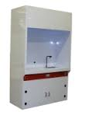

How to participate in occupational risk prevention?
How to protect yourself from risks?
Safety Equipments
Clean bench
Notes:
Développer la présentation des principaux risques spécifiques à votre UT.

Slide 45
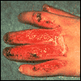
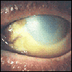
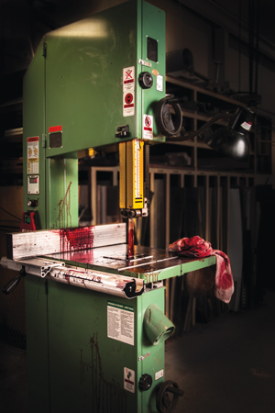
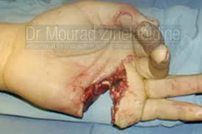
Examples of an accident
Chimical burn
Chimical projection
View of a fume sorbonne under which the fire is gone

Slide 46
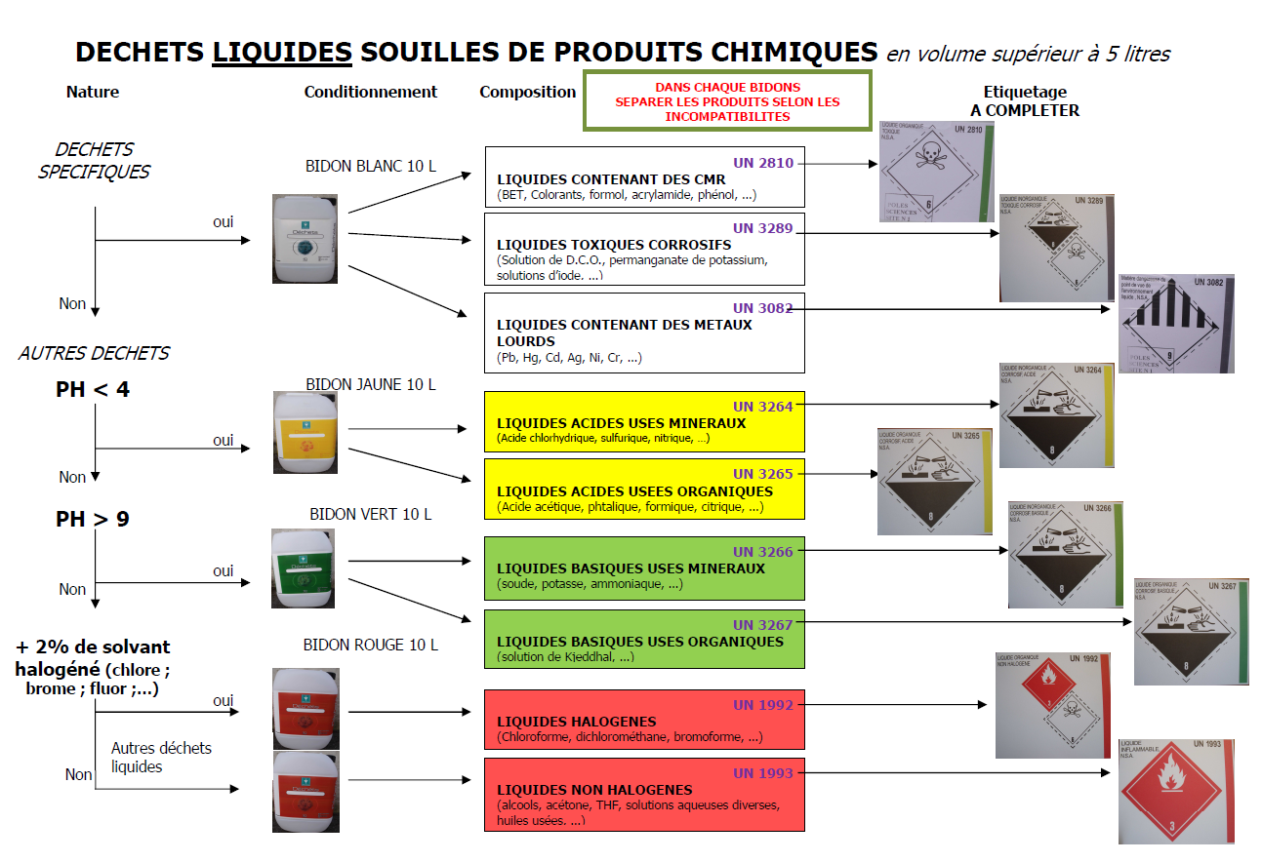
How to participate in occupational risk prevention?
How to protect yourself from risks?
Waste sorting
Notes:
Développer la présentation des principaux risques spécifiques à votre UT.

Slide 47


The different steps of risk control being completed
We can start
to handle….!!!!!

Slide 48
How to report a danger ?

Slide 49
How to report a danger ?
The different registers
Protocol for reporting and taking care of situations of stress at work or suspicion of harassment
Register of seriuos and imminent danger
  Acessible within the HSE department under the responsibility of the president
Register of Health and Safety
  Acessible within the UT under the responsability of the Unit manager
  Made available to staff and users
  Helds by the safety advisor
  Contains the comments and suggestions of the members of staff about the prevention of occupational risks and the improvement of working conditions

Slide 50
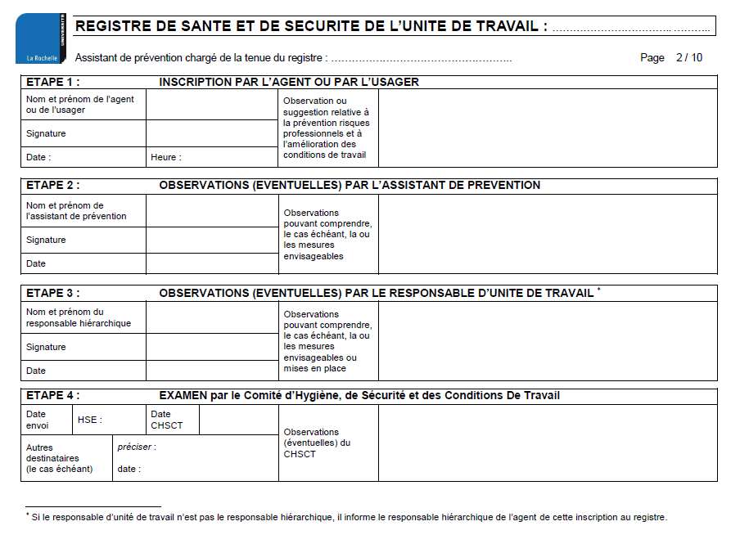
How to report a danger ?
Register of Health and Safety

Slide 51
Fire Safety?

Slide 52
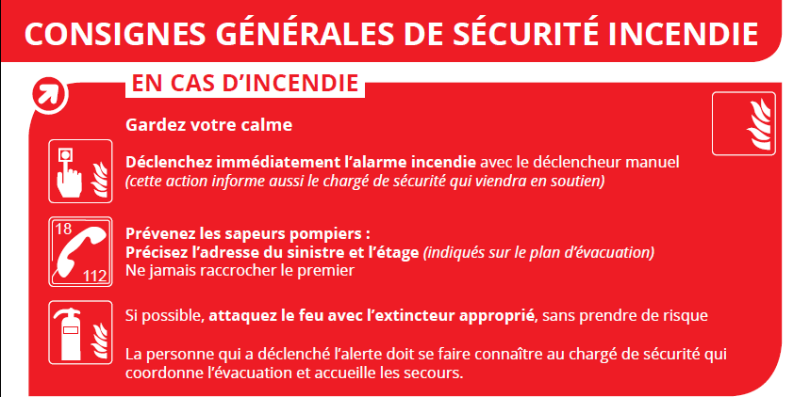
In case of fire ?
If you discover a fire

Slide 53
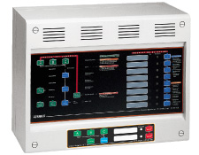
In case of fire ?
If you discover a fire
RAISE THE ALARM

Slide 54
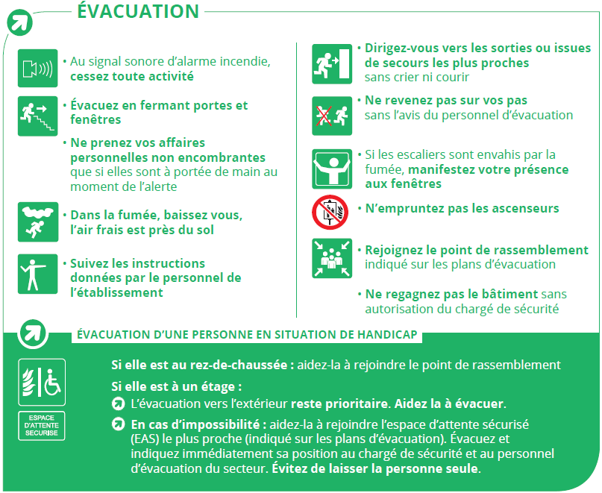
In case of fire ?
If you hear the fire alarm

Slide 55
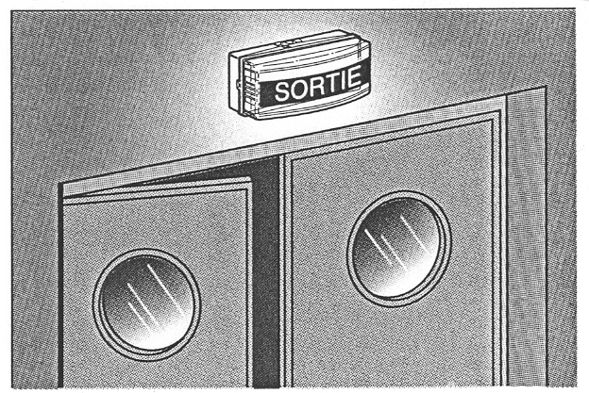

In case of fire ?
Evacuation
EXIT

Slide 56
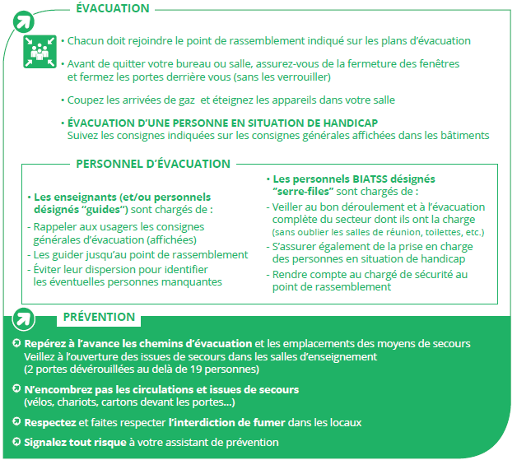
In case of fire ?
Evacuation

Slide 57
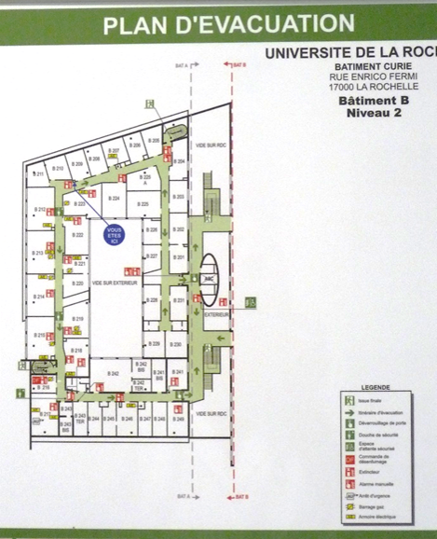
In case of fire ?
Evacuation
Evacuation Plan of the UT
Assembly Point
Notes:
Insérer un plan d’évacuation de votre UT (les prendre en photos par exemple) et indiquer le point de rassemblement.

Slide 58
In case of medical emergency?

Slide 59
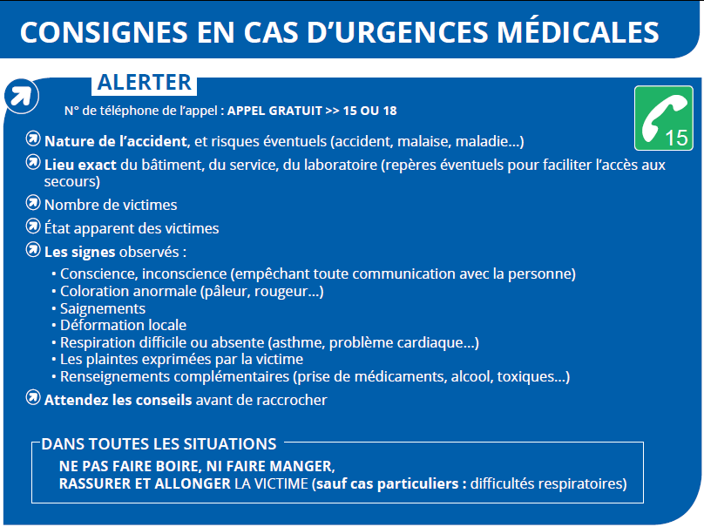
In case of medical emergency ?

Slide 60
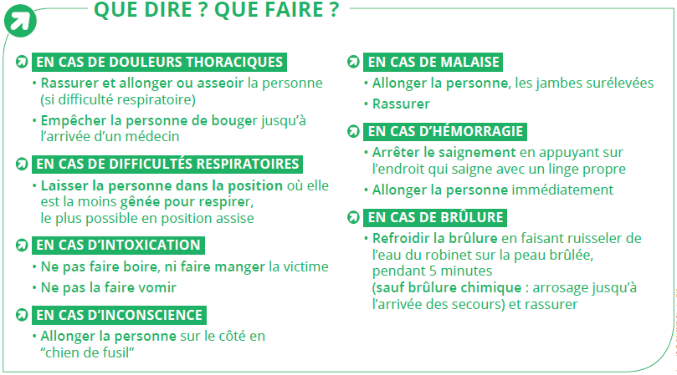
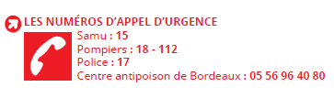
In case of medical emergency ?

Slide 61
In case of medical emergency ?
Localisation of first-aid kits
    On each floor in the lunch room
List of people trained in first-aid
- safety advisor
- lecturers
- security operator
Notes:
Indiquer la localisation de.s trousse.s de secours,
Insérer le plan de localisation des défibrillateurs,
Et indiquer la liste des personnes formées aux premiers secours.

Slide 62
In case of medical emergency ?
Location map of defibrillator
Notes:
Indiquer la localisation de.s trousse.s de secours,
Insérer le plan de localisation des défibrillateurs,
Et indiquer la liste des personnes formées aux premiers secours.

Slide 63
Conclusion

Slide 64
Conclusion
Are you ready ?
You know :
  The environment of your workstation
  Your working conditions
  What to do in case of accident or emergency
If in doubt, do not hesitate : ask your supervisor and/or your safety advisor

Slide 65
Conclusion
Are you ready ?
The training at the workstation is to be completed by your supervisor:
  Presentation of tools, procedures and work equipment
  How to use equipment anf facilities
  - the safest behaviour and actions (with demonstrations if possible)
  - the procedures used
  - the operation of the protective and emergency devices and the reason
  for their use
  - the conditions for the use of specific materials or products
  Any specific evacuation instructions in case of explosion, accidental release of gas or flammable or toxic product, if justified by the nature of activities performed.
If any doubt, do not hesitate : ask for your supervisor and/or your safety advisor

Slide 66
Know good laboratory pratices
The staff of managers to accompany you in your steps
  moves
  Registration
  Training
Purchase
> computer (Antony and Bruno with the supervisor )
Communication (Vladimir, Antony, Camille)
> poster
> activities (Adocs…)

